Slide 1

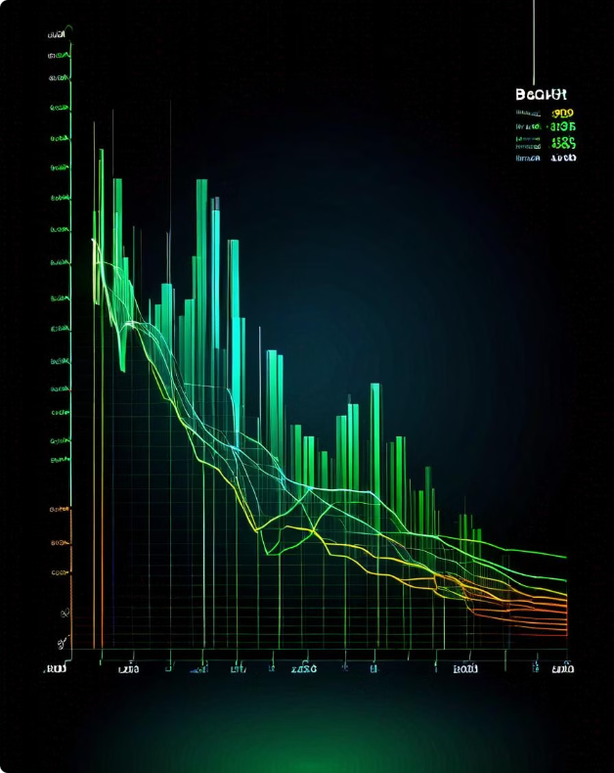

Predicting Bitcoin Prices
This presentation will outline a method for predicting Bitcoin prices using advanced time series analysis, aiming to provide traders and investors with valuable insights for informed decision making.
by Afif Salman

Slide 2

Introduction
1
Objective
2
Methodology
3
Target Audience
Develop a model to predict Bitcoin prices with reasonable accuracy, providing traders and investors with actionable insights for informed decisions.
The presentation will focus on time series analysis, specifically the SARIMA model, to analyze historical Bitcoin price data and forecast future price trends.
This presentation is designed for individuals interested in cryptocurrency markets, specifically Bitcoin, including traders and investors looking to enhance their trading strategies.

Slide 3

Data Acquisition & Preparation
Data Acquisition
1
Data Source: Kaggle Dataset Link: Cryptocurrency Price History Dataset
2
Data Cleaning
Remove any missing or erroneous data points, ensuring a clean dataset for consistent analysis and accurate model training.
Feature Engineering
3
Create new features from existing data, potentially including daily trading volume or market sentiment, to improve model performance.

Slide 4


Exploratory Data Analysis (EDA)
Visualize the Data
Stationarity Test
Differencing
Create a line plot of the Bitcoin closing prices over time to identify trends, seasonality, and any potential outliers.
Apply the Augmented Dickey-Fuller (ADF) test to determine if the data is stationary, a crucial requirement for effective time series analysis.
If the data is non-stationary, apply differencing to stabilize the mean and variance of the data, ensuring consistent patterns for modeling.

Slide 5
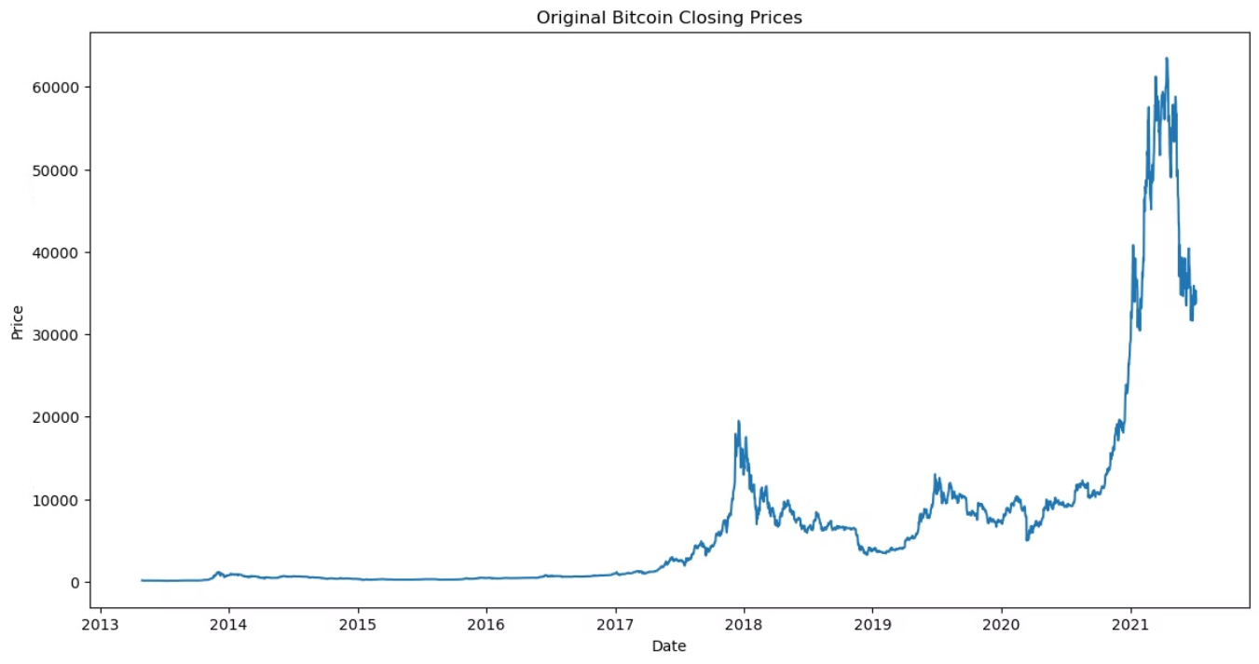
Plot the original Bitcoin closing prices to visualize the data.
This gives an overview of the time-series data we are working with.

Slide 6
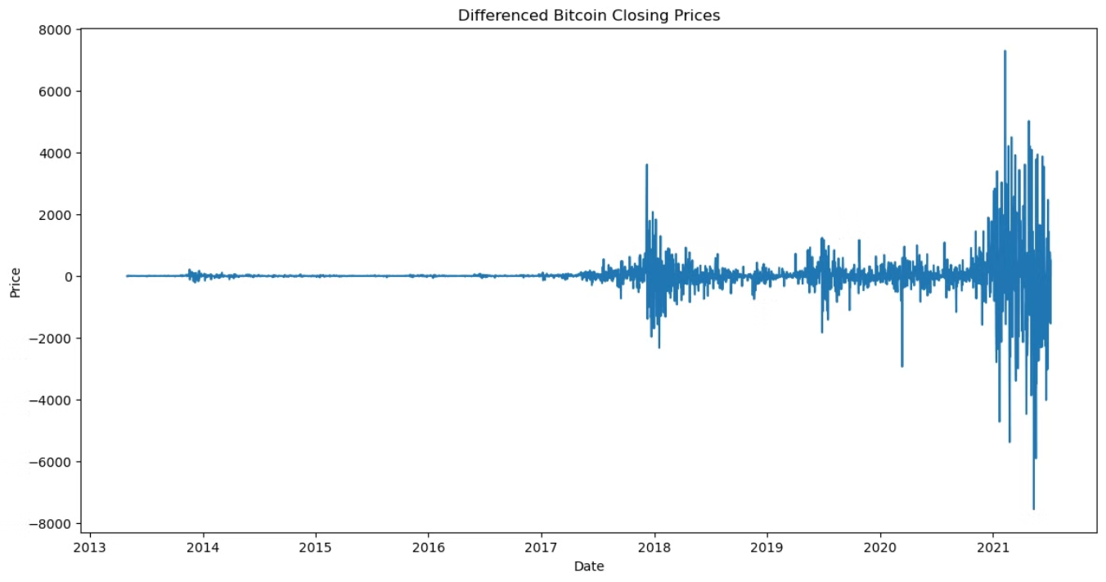
Apply differencing to make the data stationary if necessary.
Plot the differenced data.

Slide 7





Model Selection & Training
ACF & PACF Analysis
Examine the Autocorrelation Function (ACF) and Partial Autocorrelation Function (PACF) plots to determine the parameters for the SARIMA model, including AR, MA, and I orders.
SARIMA Model Selection
Use auto_arima to automatically select optimal parameters for the SARIMA model based on the Akaike Information Criterion (AIC), simplifying the process.
Model Training
Train the chosen SARIMA model on the prepared training data, allowing the model to learn the underlying patterns and relationships within the data.

Slide 8
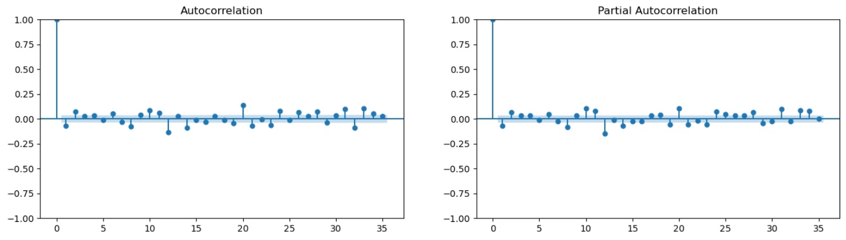
Plot ACF & PACF of the differenced data.

Slide 9
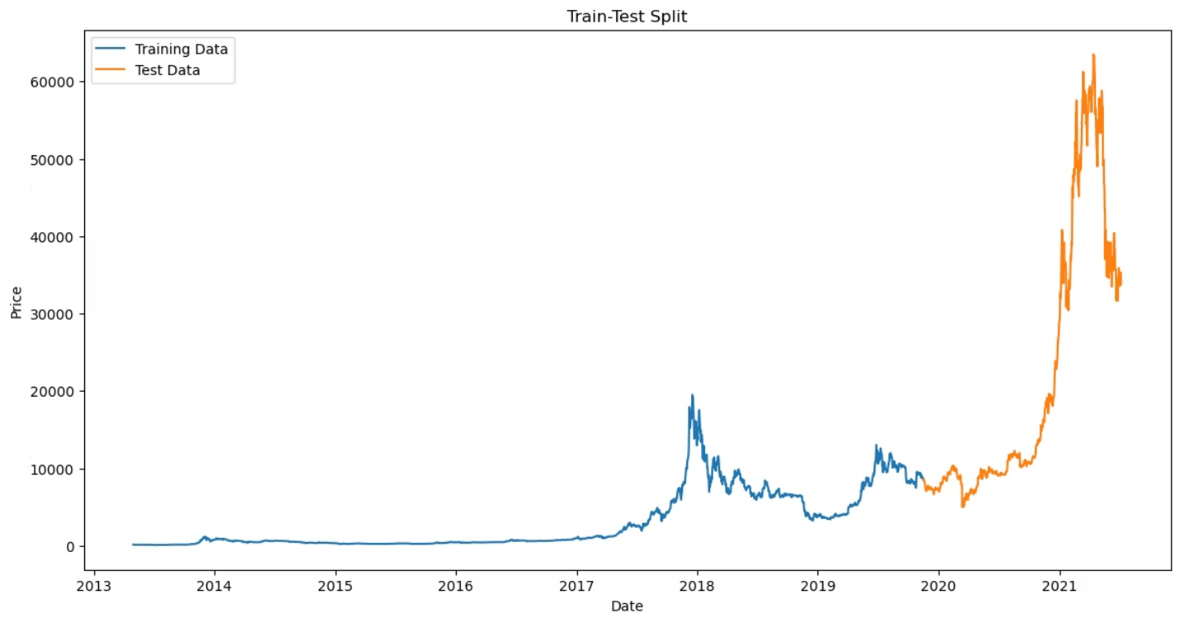
Train-Test Split

Slide 10

Model Evaluation & Forecasting
Metric
Value
Mean Squared Error (MSE)
437327606.99690646
A lower MSE indicates that the SARIMA model's forecasts closely match the actual Bitcoin prices.
This metric serves as a benchmark for prediction accuracy, providing confidence in the reliability of our forecasts for traders and investors.

Slide 11
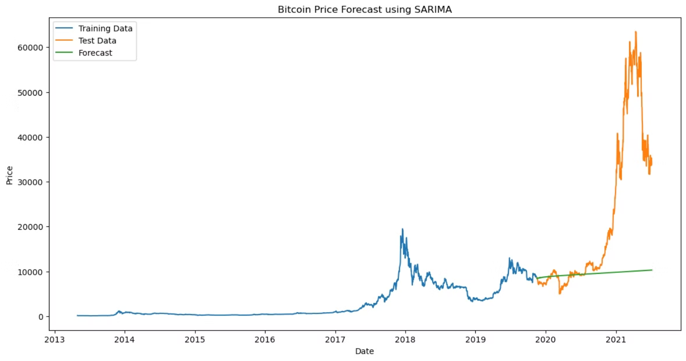
Bitcoin Price Forecast using SARIMA

Slide 12



Conclusion & Future Work
Model Performance
The SARIMA model demonstrated successful prediction of Bitcoin prices, indicating its potential for informed decision-making in the cryptocurrency market.
Future Research
Further exploration of advanced models like LSTM could enhance predictive accuracy, and incorporating additional features like trading volume might provide deeper insights.

Slide 13

References
Nakamoto, S. (2008). Bitcoin: A Peer-to-Peer Electronic Cash System. Retrieved from https://bitcoin.org/bitcoin.pdf
Hyndman, R. J., & Athanasopoulos, G. (2018). Forecasting: principles and practice (2nd ed.). OTexts.
Box, G. E. P., Jenkins, G. M., Reinsel, G. C., & Ljung, G. M. (2015). Time Series Analysis: Forecasting and Control (5th ed.). Wiley.
Enders, W. (2014). Applied Econometric Time Series (4th ed.). Wiley.
Brockwell, P. J., & Davis, R. A. (2016). Introduction to Time Series and Forecasting (3rd ed.). Springer.

